Slide 1


SP led controller Product
Description
Rose lighting

Slide 2
Preface
Product Category
CONTENTS
product description
Other-commonly used knowledge points

Slide 3
1
Preface

Slide 4
Company Profile
*Rose Lighting is professional led strip manufacturer ,which integrating production, R&D sales and engineering .
we focus on led strip and project solution since 2012 in shenzhen china。
focused on manufactuering led strip more than 10 years.
competitive price and project engineering solution service.
more than 100 project case each year .
all Types of led strip and free sample are available.
skilled support team and engineering service.
visable all kinds of project case show and Exhibition board in our showroom .
OEM/ODM offered.
realiable and guaranteed payment by alibaba.
same Quality Management as OSRAM and Thorn.ect .(we work with same Quality Management Company ).

Slide 5
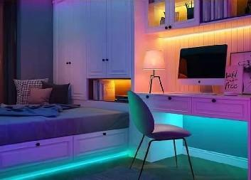
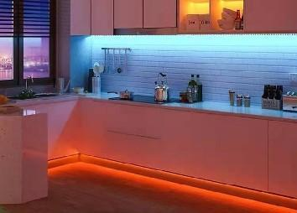
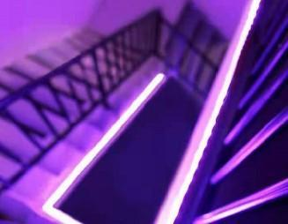
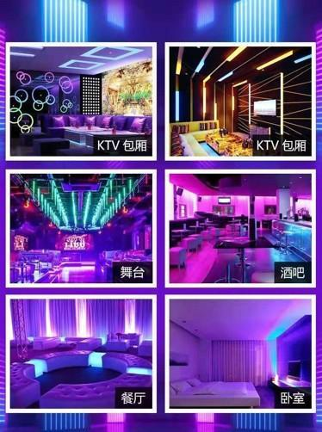
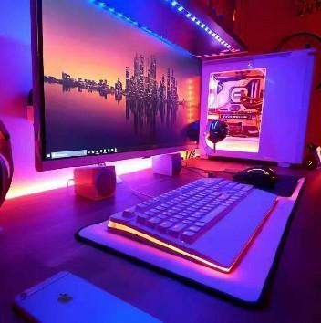
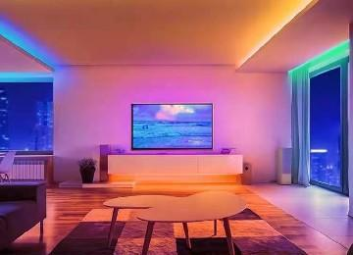
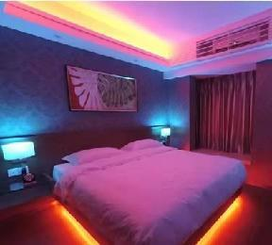
Case appreciation
lighting scene

Slide 6
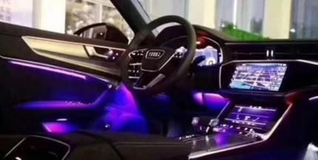
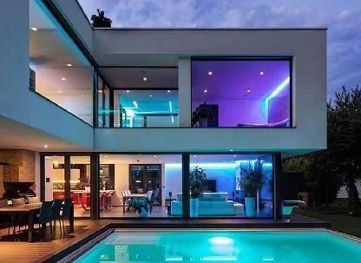
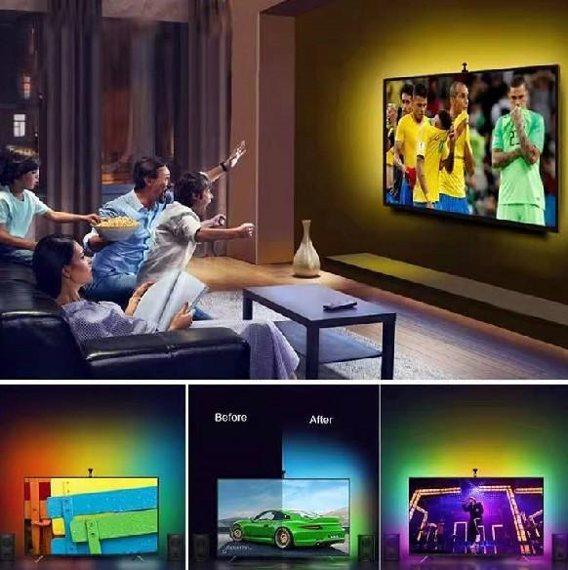

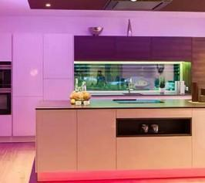
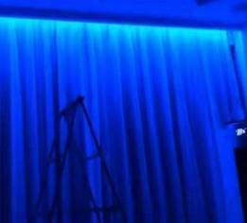
Case appreciation
Atmosphere area

Slide 7
2
Product Category

Slide 8

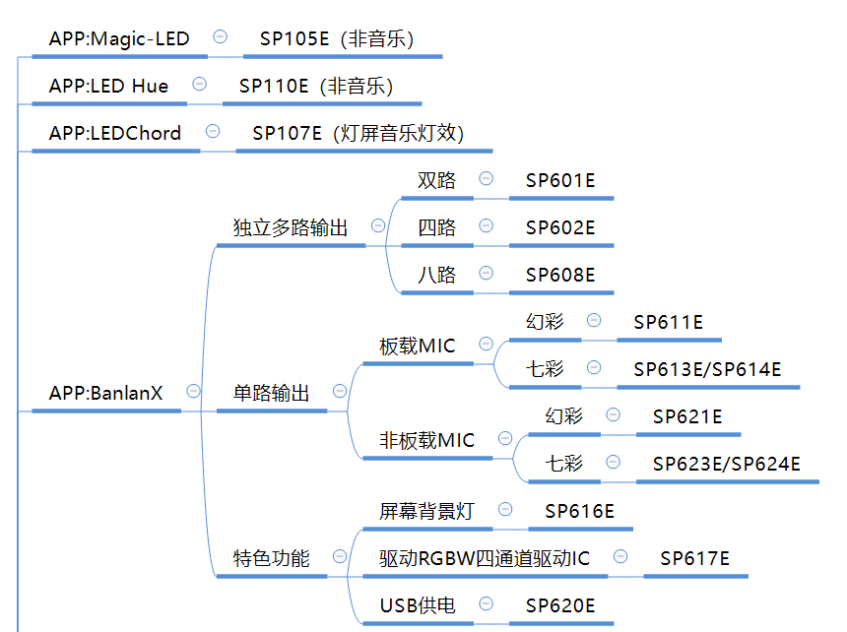

Product Category

Slide 9
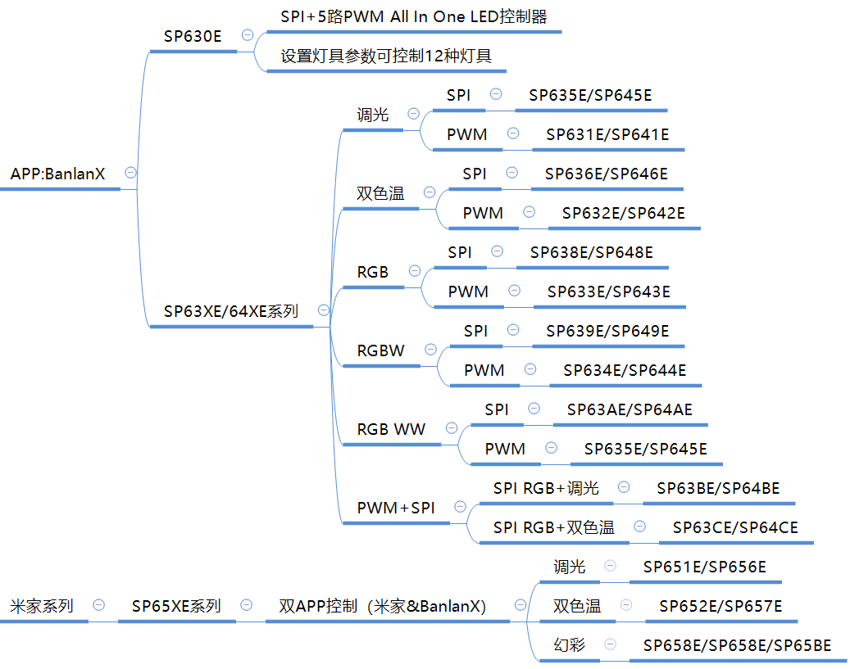

Product Category

Slide 10
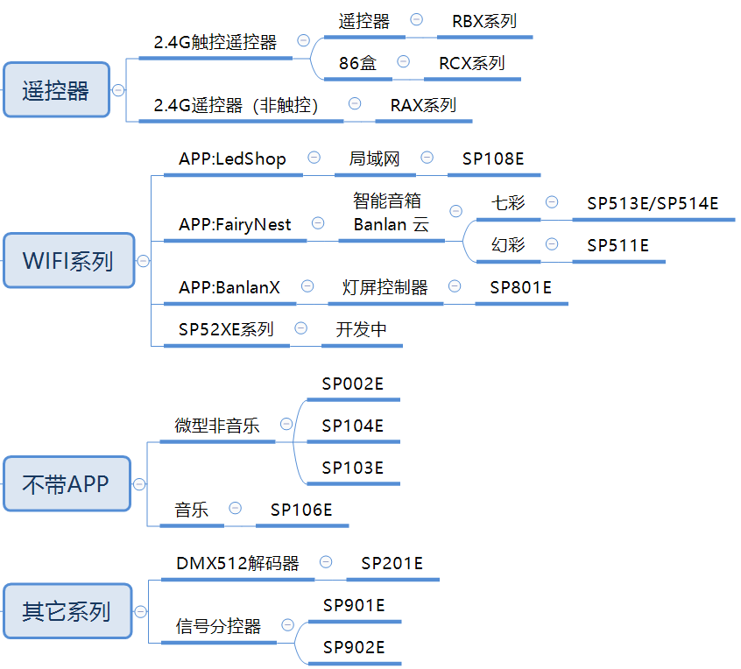
Product Category

Slide 11
3
Product Description

Slide 12
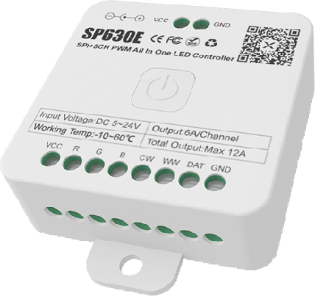
Product Description
SP630E SPI+5roadPWM All In One LED controller：
Features：
SP630E is an LED controller (All in one) that can control multiple types of lamps. It can control single-channel, dual-channel, three-channel, four-channel, and five-channel colorful and phantom lamps; it can also control hybrid lamps ( PWM+SPI).
1. High performance, low power consumption 2.4G Bluetooth master control;
2. Supports control of up to 12 types of lamps;
3. Supports multiple control methods such as mobile APP, 2.4G touch remote control and 2.4G touch 86 box;
4. Supports setting a variety of power on and off dynamic effects and default power on state;
5. Supports modifying device name, color correction and adding multiple timers;
6. Supports multiple music collection modes: mobile phone microphone, player streaming, onboard microphone;
7. Five major control pages: dynamic page, static page, music page, custom page and setting page; different lamp types correspond to different control interfaces;
8. Through the touch remote control, you can set up zone control (can be divided into 4 zones), or unified control (ALL).

Slide 13
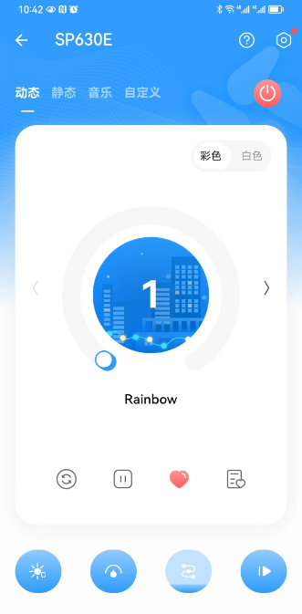
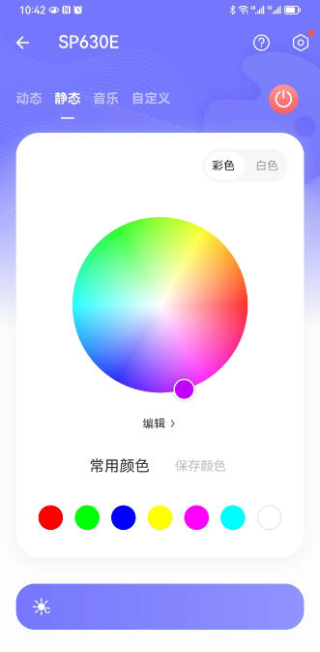
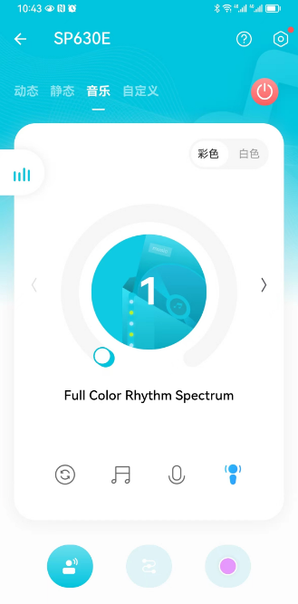
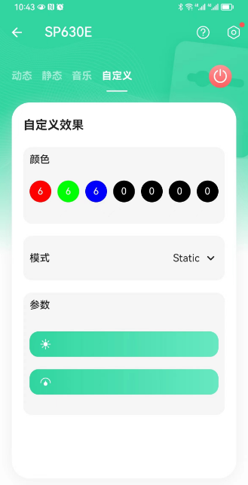
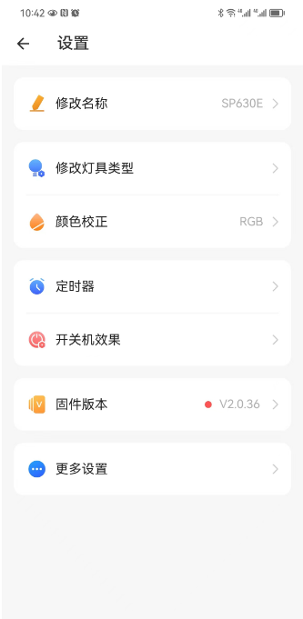
Product Description
SP630E SPI+5-channel PWM All In One LED controller-part of the APP interface:
Dynamic interface
static interface
music interface
DIY interface
Set interface

Slide 14
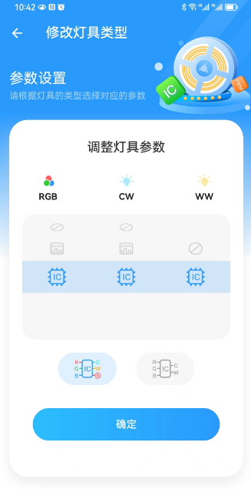
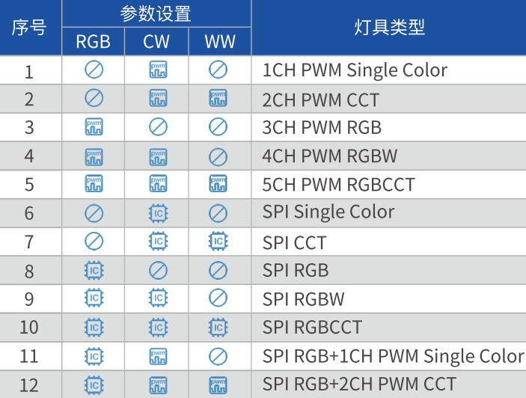
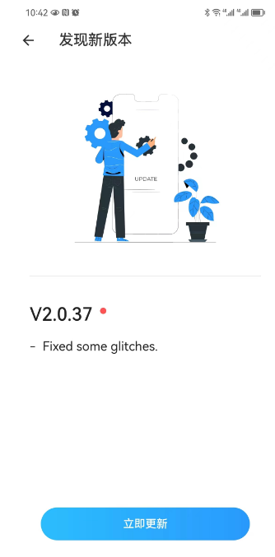
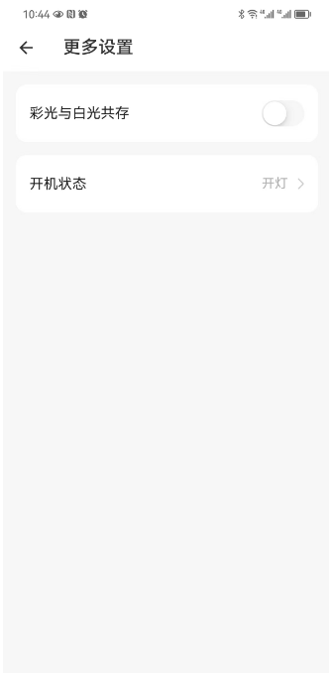
Product Description
SP630E SPI+5-channel PWM All In One LED controller-part of the APP interface：
Set fixture type
How to set up 12 lamp types
OTA upgrade
More settings

Slide 15
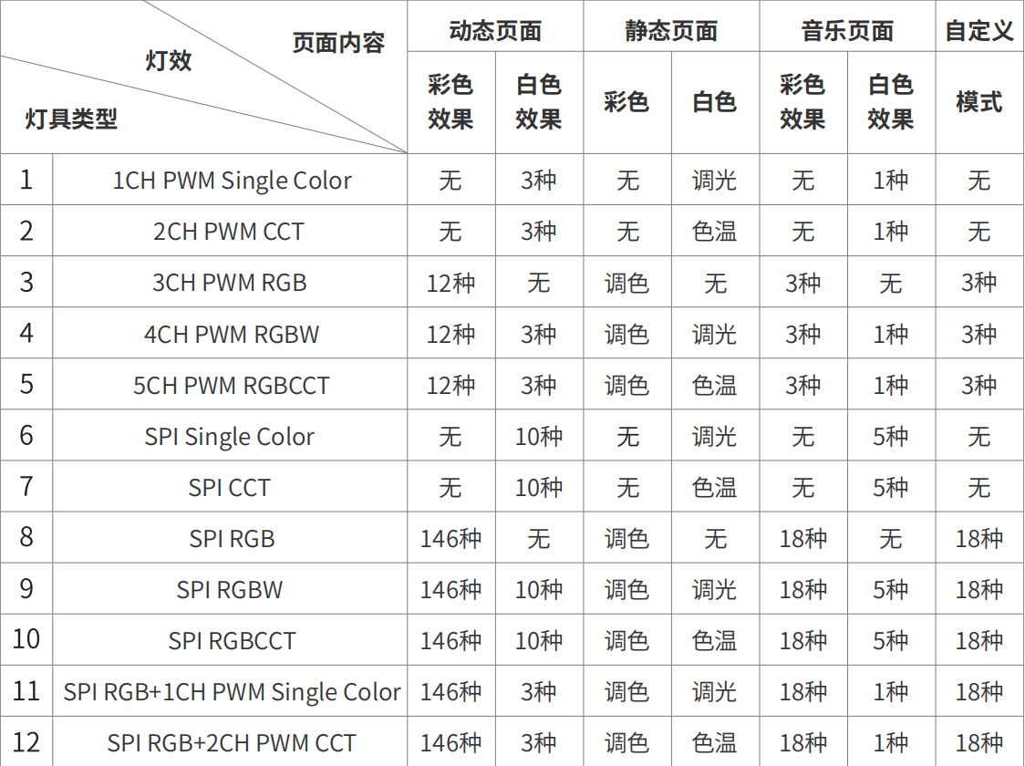
Product Description
SP630E -12 lamp types correspond to 12 control interfaces:

Slide 16
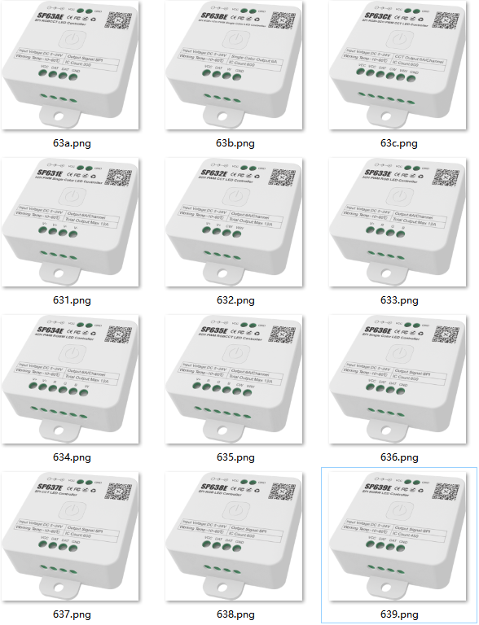
Product Description
SP63XE series Bluetooth music LED controller series：
Features:
1. Supports multiple control methods such as mobile APP, 2.4G touch remote control and 2.4G touch 86 box;
2. PWM supports 8KHZ high-frequency PWM dimming and high-power MOS output;
3. SPI supports conventional return-to-zero code single-line driver ICs. SP636E-SP638E and SP63BE-SP63CE support three-channel driver ICs; SP639E supports four channels; SP63AE supports six channels;
4. Five major control pages: dynamic page, static page, music page, custom page and setting page; different models have different control pages;
5. Built-in rich dynamic effects and music effects;
6. Compatible with multiple music collection modes: mobile phone microphone, player streaming, onboard microphone
7. Supports power-on and off animation effects and power-on status selection;
8. Support calibration channel sequence and timing switch;
9. Support OTA firmware upgrade;
10. Support automatic connection, automatic reconnection and multi-device grouping;
11. Through touch remote control, you can set up zone control (can be divided into 4 zones), or unified control (ALL);
12. The full range of products has powerful functions and complete models, covering almost all types of lamps on the market.

Slide 17
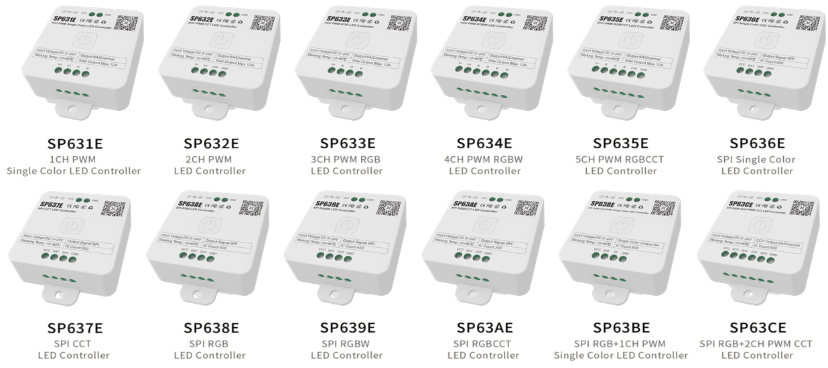
Product Description
SP63XE series - 12 models matching 12 lamp types:

Slide 18
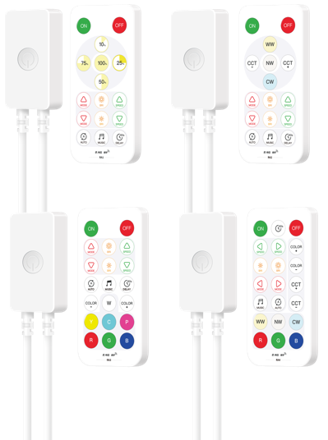
Product Description
SP64XE series Bluetooth music LED controller series:
Features:
1. Supports mobile APP and 2.4G remote control control;
2. PWM supports 8KHZ high-frequency PWM dimming;
3. SPI supports conventional return-to-zero code single-line driver ICs. SP646E-SP648E and SP64BE-SP64CE support three-channel driver ICs; SP649E supports four channels; SP64AE supports six channels;
4. Five major control pages: dynamic page, static page, music page, custom page and setting page; different models have different control pages;
5. Built-in rich dynamic effects and music effects;
6. Compatible with multiple music collection modes: mobile phone microphone, player streaming, onboard microphone
7. Supports power-on and off animation effects and power-on status selection;
8. Support calibration channel sequence and timing switch;
9. Support OTA firmware upgrade;
10. Support automatic connection, automatic reconnection and multi-device grouping;
11. The remote control supports one-to-many and many-to-one control;
12. The full range of products has powerful functions and complete models, covering almost all types of lamps on the market.

Slide 19
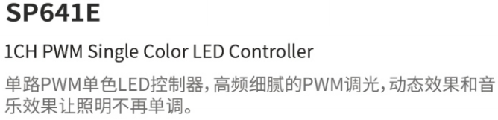
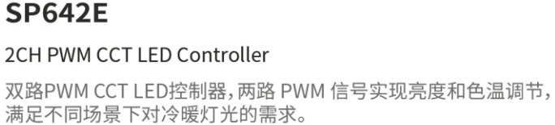
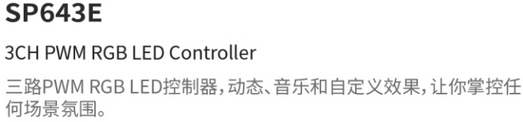
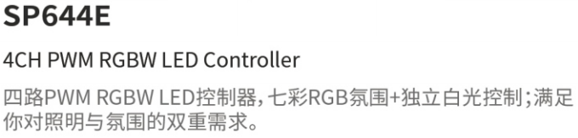
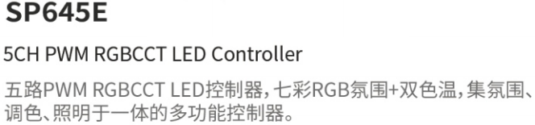
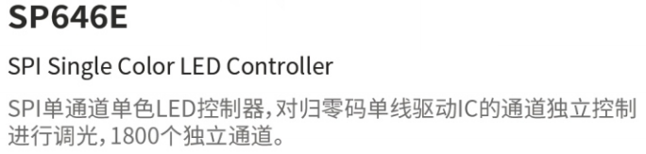
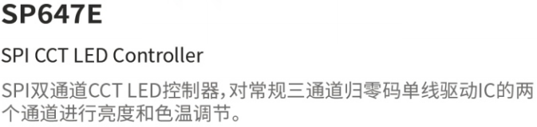
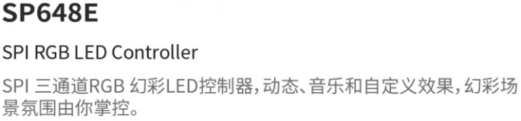
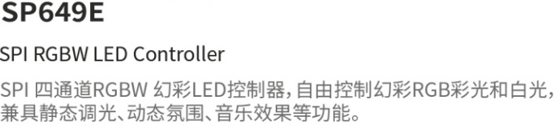
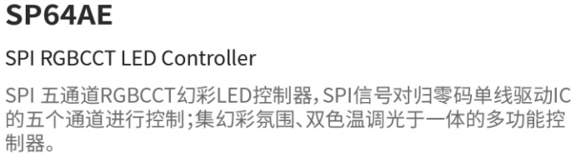
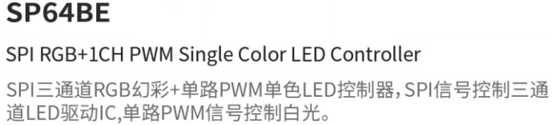
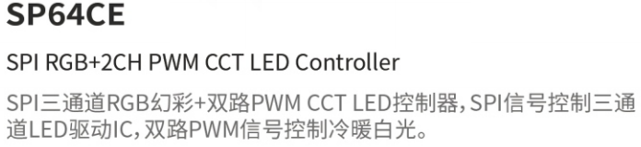
Product Description
SP64XE series - 12 models matching 12 lamp types:

Slide 20
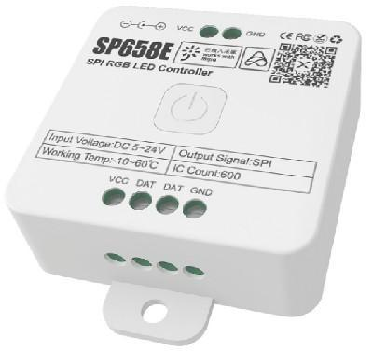
Product Description
SP65XE Series Dual APP Symphony Music Controller Series:
Features:
This series of products has been connected to Mijia and can be controlled through Mijia APP or Xiaoai’s voice control; it also supports control by our BanlanX APP. Built-in a variety of dynamic lighting effects and music rhythm effects. Supports multi-parameter adjustment such as brightness, speed, direction and effect length. Full color light color palette, independent white light dimming control interface. Easily create a festive atmosphere, light rhythm, lighting dimming and other scenarios, can meet your lighting needs in various scenes, and can easily create your ideal lighting atmosphere.
1. Supports the control of two APPs: "Mijia" and "BanlanX";
2. Support Xiaoai voice control, remote mobile phone control, intelligent scene linkage and other functions;
3. Supports 2.4G touch remote control and 2.4G touch 86-box remote control;
4. Supports conventional return-to-zero code single-line driver IC, SP658E supports three-channel driver IC, SP659E supports four-channel, SP65BE supports three-channel driver IC and one PWM signal;
5. Built-in multiple dynamic effects and music effects, multiple parameters can be adjusted;
6. Supports a variety of switch animation effects;
7. Support timing switch;
8. Support OTA firmware upgrade.
Tip: More dynamic effects, music effects, DIY effects, calibration channel color and other functions need to be connected to the "BanlanX" APP to use。
SP651E | 1CH PWM Single Color LED Controller
SP652E | 2CH PWM LED Controller
SP656E | SPI Single Color LED Controller
SP657E | SPI CCT LED Controller
SP658E | SPI RGB LED Controller
SP659E | SPI RGBW LED Controller
SP65BE | SPI RGB+1CH PWM Single Color

Slide 21
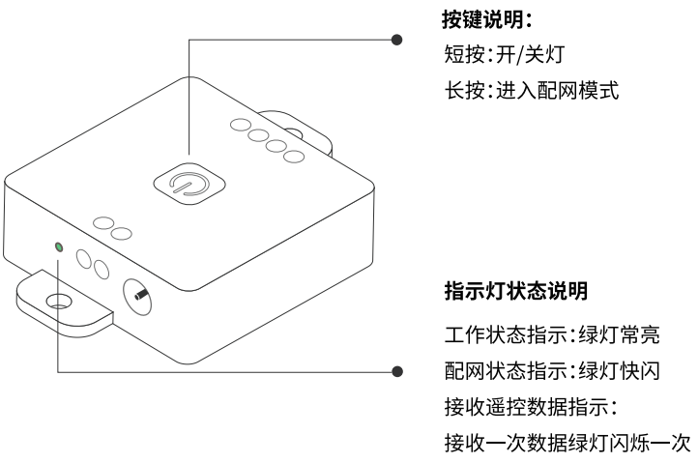
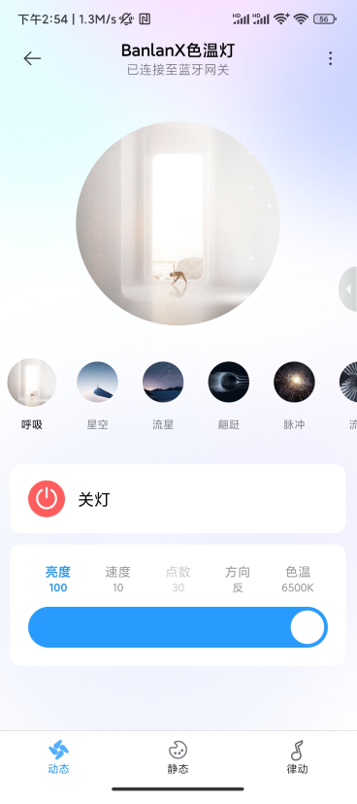
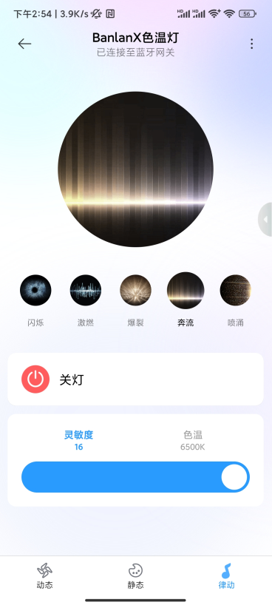
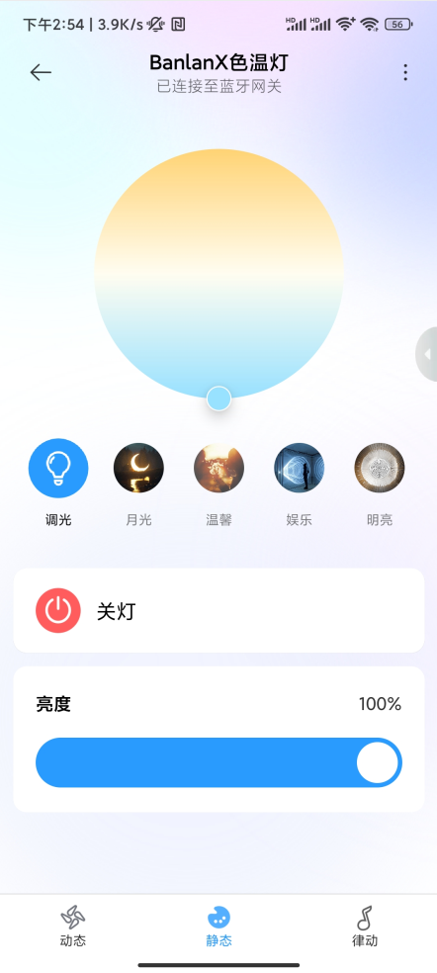
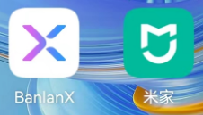

product description
SP65XE Series Dual APP Symphony Music Controller-Part of the APP Interface:
Note: This product needs to be paired with Xiaoai speakers and other products to achieve intelligent control. Please scan the QR code for a list of compatible products.：
Mijia APP control interface

Slide 22
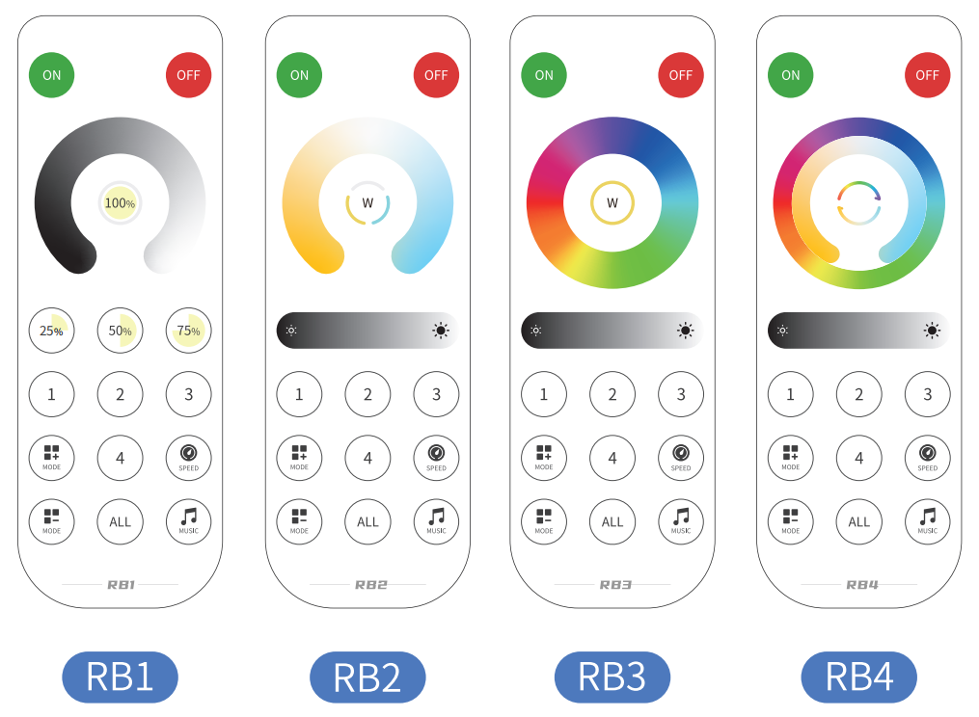
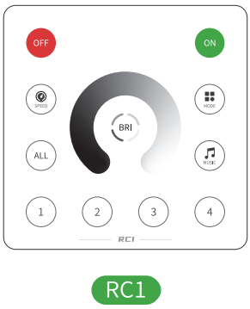
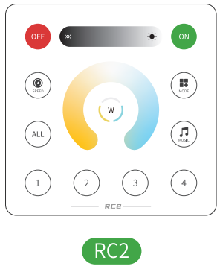


Product Description
RBX series and RCX series 2.4G touch remote control series：
Features:
The remote controls RBX series (RB1, RB2, RB3, RB4) and 86-box RCX series (RC1, RC2, RC3, RC4) are touch-based 2.4G wireless remote controls; they can be used with our SP630E, SP63XE, SP520E, SP52XE series controllers Matching use.
1. Using 2.4G wireless remote control technology, it has the characteristics of low transmission power, low power consumption, long transmission distance, strong anti-interference ability, and fast transmission speed;
2. Using capacitive touch IC, it has high sensitivity, good consistency and strong reliability;
3. Support one-to-many control, one remote control can control multiple controllers;
4. Supports many-to-one control, one controller can be bound to multiple remote controls (up to 5);
5. Support unified control and 4 partition control;
It must match the controller model when used, otherwise some remote control functions may fail.。

Slide 23

Product Description
RBX Series and RCX Series 2.4G Touch Remote Control Series-Setup Instructions：
Binding, unbinding, clearing and partition settings:
light button
Short press: turn on the light
Long press: Within 20 seconds after the controller is powered on, long press the ON button to bind/unbind the remote control.
Lights off button
Short press: turn off the light
Long press: Within 20 seconds after the controller is powered on, first turn off the lights completely, and then press and hold the OFF button to clear all bound remote controls.
partition key
Short press: Select a zone and perform specific control on the controller of a specific zone individually. For example, short press ① first and then press the remote control, only the controller of Zone 1 will respond to this operation;
Long press: Perform partition setting. Within 20 seconds after the controller is powered on, press and hold a key ①-④ to set the partition.
All partitions
Short press: select all partitions and control all partitions uniformly;
Long press: Within 20 seconds after the controller is powered on, long press ALL to cancel partition settings。

Slide 24
Product Description
Controller matching remote control model description：
Controller model |  |  | Match the remote control model
 |  |  | RA series | RB series | RC series
SP631E | SP651E | SP641E | RA1 | RB1 | RC1
SP632E | SP652E | SP642E | RA2 | RB2 | RC2
SP633E | ------ | SP643E | RA3 | RB3 | RC3
SP634E | ------ | SP644E | RA3 | RB3 | RC3
SP635E | ------ | SP645E | RA4 | RB4 | RC4
SP636E | SP656E | SP646E | RA1 | RB1 | RC1
SP637E | SP657E | SP647E | RA2 | RB2 | RC2
SP638E | SP658E | SP648E | RA3 | RB3 | RC3
SP639E | SP659E | SP649E | RA3 | RB3 | RC3
SP63AE | ------ | SP64AE | RA4 | RB4 | RC4
SP63BE | SP65BE | SP64BE | RA3 | RB3 | RC3
SP63CE | ------ | SP64CE | RA4 | RB4 | RC4
illustrate:
1. SP63XE/65XE series can be equipped with RB and RC series;
2. SP64XE series comes standard with RA series;
3. RB and RC are 2.4G touch remote controls;
4. RA is a 2.4G remote control (non-touch).

Slide 25

Product Description
SP801E WiFi Art-Net LED Controller:
Features:
1. Mobile APP control;
2. Adopt blufi bluetooth auxiliary network distribution method and dual-mode chip to maximize the network distribution experience;
3. Two working modes: AP mode and STA mode (LAN);
4. Two layout methods: regular layout and imported DXF layout file; regular layout has visual layout, wiring and port configuration windows, which is simple and intuitive; imported DXF method is suitable for more complex layout and wiring scenarios , you can import it with one click;
5. After completing the configuration, you can create and edit effects. It has built-in multiple types of layer effects and supports layer overlay;
6. Layer effects support multi-dimensional customization: parameters such as direction, width, color, length, shape, and number can all be edited;
7. Effects support online preview and recording as scenes saved to the controller;
8. Compatible with Art-Net protocol, other host computers based on Art-Net protocol in the same LAN can control SP801E;
9. The firmware supports OTA online upgrade; the default FLASH capacity is 128M.
SP801E is a WiFi Art-Net LED controller built with great efforts by our company; it innovatively developed a light screen control APP; users can complete layout, wiring, preview and recording effects directly on their mobile phones。

Slide 26














Product Description
SP801E WiFi Art-Net LED Controller-Part of the APP interface:

Slide 27

Product Description
SP60XE series multi-channel independent output colorful LED controller：
SP601E
SP602E
SP608E

Slide 28



Product Description
SP60XE series multi-channel independent output colorful LED controller:
Features:
1. Two control methods: mobile APP + RF remote control;
2. Supports the output of multiple different signals, and each channel can be controlled individually or uniformly;
3. Innovative scene application methods, and the scene mode can automatically cycle;
3. Both 602 and 608 have 4 built-in triggers;
4. 601 supports device grouping, and 602 and 608 support channel grouping.
5. Supports common single-line LED driver ICs on the market such as: SM1603, TM1804, UCS1903, WS2811, etc. (manual selection of IC models is not supported);
6. The APP automatically connects to the device when it starts and automatically reconnects to the device after an unexpected interruption, allowing users to maximize the intelligence and stability of the connection;
7. Onboard high-sensitivity microphone ensures rhythmic sampling of music effects;
SP601E
SP602E
SP608E

Slide 29




Product Description
SP60XE series multi-channel independent output colorful LED controller - interface difference description:
illustrate:
Take the 602 interface as an example;
1. Compared with 601, 602 608 APP has an increased number of channels, a new trigger interface and channel grouping interface, and the functions and usage methods are the same;
2. The trigger is a high-level trigger, and the high-level range is 5-24V; it has 4 built-in triggers and supports customization of trigger effect parameters;
3. 10 channel groups can be added, and the channels can be combined in any way.
Channel interface
601 602 608
Scene interface
601 602 608
trigger interface
602 608
Group interface
602 608

Slide 30



Product Description
SP60XE series multi-channel independent output colorful LED controller - part of the APP interface：
illustrate:
1. 60X is a multi-channel signal output, and each channel is completely independent, so multiple output signals cannot be connected together;
2. Built-in 40 classic dynamic effects, the color, effect length, direction, speed, and brightness can all be set; that is, one effect mode can be set to a variety of combinations of colors, effect lengths, etc.; (such as a single The color meteor effect can be adjusted to any color meteor through the color palette;)
3. Clever use of effect length can also achieve basic layout operations;
4. For static colors, you can enter the color code value to accurately locate the required color number;
5. Audio collection method: 601 and 602 have on-board high-sensitivity microphones, and 608 adds an on-board audio socket;
General dynamic effects interface
Music effects interface
static color interface

Slide 31

Product Description
SP61XE/62X Series Bluetooth Symphony/Colorful Music LED Controller:

Slide 32

Product Description
SP611E SP617E Bluetooth Symphony Music LED Controller:
Features:
1. Supports mobile APP, infrared IR remote control and other control methods; (standard IR remote control)
2. Supports automatic connection to the device when the APP is started and automatic reconnection of the device after disconnection;
3. Support group control of multiple devices;
4. Supports multiple music collection modes: mobile phone microphone, player streaming, and onboard microphone;
5. Supports modification of device name, calibration channel sequence, timer and other functions;
6. 611 supports common three-channel driver ICs and supports 600 pixels; 617 supports common four-channel driver ICs and supports 450 pixels;
7. 611 has 142 built-in dynamic modes, and 617 has 152 built-in effect modes (10 new independent W channel white light dynamic effects). Both support dynamic mode effect length adjustment, dynamic mode collection, and dynamic mode and collection mode can be cycled independently. ;
8. 617 static color interface, a new white light control mode is added to control W channel white light (this white light is an independent W channel white light, not a RGB mixed white light);
9. Built-in 18 music modes, supporting music mode effect length adjustment, sensitivity adjustment, effect color selection and music mode loop;
10. DC5~24V wide voltage input, the power supply has anti-reverse connection function;
11. Function of saving setting parameters after power off。

Slide 33





Product Description
SP611E SP617E Bluetooth Symphony Music LED Controller-Part of the APP Interface：
611 static color interface
611 regular dynamic effects interface
617 static color interface
617 regular dynamic effects interface
Music effects interface

Slide 34



Product Description
SP613E/SP614E Bluetooth Music RGB/RGBW LED Controller：
Features:
1. Supports mobile APP, infrared IR remote control and other control methods;
2. Supports automatic connection to the device when the APP is started and automatic reconnection of the device after disconnection;
3. Support device group control;
4. Supports multiple music collection modes: mobile phone microphone, player streaming, and onboard microphone;
5. Supports functions such as modifying device name, calibrating RGB channel sequence, timer, etc.;
6. Comes with a variety of non-music and music effects, and supports user-defined effects;
7. DC5~24V wide voltage input, the power supply has anti-reverse connection function;
8. The function of saving setting parameters after power failure。
SP613E: +RGB interface (4pin)
SP614E: +RGBW interface (5pin)

Slide 35




product description
SP613E/SP614E Bluetooth Music RGB/RGBW LED Controller-Part of the APP Interface:
illustrate:
1. 614 controls the RGBW light strip; the white light is a separate W lamp bead;
2. 613 controls the RGB light strip; the white light is the white light mixed by RGB;
3. The difference between 613 and 614: the light strips controlled are different; the number of control line ports is different (613 is a 4PIN line (+RGB), 614 is a 5PIN line (+RGBW));
4. Added a new custom effect interface.
Custom effect interface
613 static color interface
614 has more individual W controls than 613
W is controlled independently and corresponds to the remote control buttons.

Slide 36



product description
SP620E SP621E Bluetooth Symphony LED Controller:

Slide 37

product description
SP623E/SP624E Mini Bluetooth Music RGB/RGBW LED Controller：
Features:
1. Support mobile APP control;
2. Supports automatic connection to the device when the APP is started and automatic reconnection of the device after disconnection;
3. Support device group control;
4. Supports two music collection modes: mobile phone microphone and player streaming;
5. Supports functions such as modifying device name, calibrating RGB channel sequence, timer, etc.;
6. Comes with a variety of non-music and music effects, and supports user-defined effects;
7. DC5~24V wide voltage input, the power supply has anti-reverse connection function;
8. The function of saving setting parameters after power failure
Description: SP623E/SP624E is Mini Bluetooth music RGB/RGBW LED controller;
The functions are basically the same as SP613E/SP614E; please refer to SP613E/SP614E for usage methods;
Differences from SSP613E/SP614E: no onboard MIC, no buttons, no shell, no remote control。

Slide 38



Product Description
SP616E Bluetooth Music & AmbiBox Software Symphony LED Controller：
Features:
1. Support mobile APP and Windows PC AmbiBox software control;
2. Supports automatic connection to the device when the APP is started and automatic reconnection of the device after disconnection;
3. Support group control of multiple devices;
4. Supports multiple music collection modes: mobile phone microphone, player streaming, and onboard microphone;
5. Supports functions such as modifying device name, calibrating RGB channel sequence, timer, etc.;
6. Supports common single-line LED driver ICs on the market, supporting driving 600 pixels;
7. Built-in 142 dynamic modes, supporting dynamic mode effect length adjustment, dynamic mode collection, and dynamic mode and collection mode can be cycled independently;
8. Built-in 18 music modes, supporting music mode effect length adjustment, sensitivity adjustment, effect color selection and music mode loop;
9. DC5V voltage input, the power supply has anti-reverse connection function;
10. Function of saving setting parameters after power off。
Note: SP616E is compatible with all functions of SP611E APP, and also adds screen background light function;
Differences from SP611E: DC5V power supply, different button functions, no remote control, and different wiring;
APP adds the function of switching to AmbiBox software control；

Slide 39





Product Description
SP62XE SP616E Bluetooth Symphony Music LED Controller Partial APP Interface：
illustrate:
The music effects of 621 623/624 include two music collection modes: mobile phone microphone and player streaming. There is no onboard MIC. Everything else is the same as 611 613/614;
Both the M mode button of the 616 shell and the APP can switch between built-in lighting effects and AmbiBox software control with one click.；
621 623/624 music effects only have two music collection modes: mobile phone microphone and player streaming.
616 Added the function of switching to AmbiBox software control

Slide 40

Product Description
SP511E WIFI smart speaker colorful music LED controller：
Features:
1. WIFI fast access technology, multiple network distribution modes (automatic network distribution and manual network distribution), can be remotely connected
process control;
2. Supports mobile APP, IR remote control, buttons and other controls. The APP is compatible with IOS and Android systems;
3. Support Amazon Alexa/Google Home voice control switch, brightness and color;
4. Support voice commands to directly call up 8 static color effect scenes and 8 dynamic effect scenes;
5. Built-in 180 kinds of dynamic effects, adjustable speed and brightness, automatic looping, 8 kinds of built-in music
Mode, sensitivity adjustable;
6. Supports modifying device name, calibrating RGB channel sequence, and firmware OTA online upgrade;
7. Supports common single-line LED driver ICs on the market, supporting driving 900 pixels;
8. DC5~24V wide voltage input, the power supply has anti-reverse connection function;
9. The function of saving setting parameters after power failure;
10. Standard infrared remote control.

Slide 41





Product Description
SP511E WIFI Smart Speaker Symphony Music LED Controller-Part of the APP Interface：
8 music effects
Hold the smart speaker to call out
Dynamic effects interface
Four effects can be collected
8 dynamic effects support smart speaker recall
8 static colors support smart speaker recall
Music effects interface

Slide 42
Product Description
SP513E/SP514E WIFI smart speaker colorful music LED controller：
Features:
1. WIFI fast access technology, multiple network distribution modes, and remote control;
2. Supports mobile APP, IR remote control, buttons and other controls. The APP is compatible with IOS and Android systems;
3. Support Amazon Alexa, Google Home and other voice control switches, brightness and color;
4. Supports voice commands to directly call up 8 static color effect scenes and 4 dynamic effect scenes.
4 DIY dynamic effect scenes and 3 music effect scenes;
5. Built-in multiple dynamic effects, speed and brightness are adjustable; built-in 3 music modes, adjustable sensitivity;
6. Supports modifying device name, calibrating RGB channel sequence, and firmware OTA online upgrade;
7. DC5~24V wide voltage input, the power supply has anti-reverse connection function;
8. The function of saving setting parameters after power failure.
SP513E: +RGB interface (4pin)
SP514E: +RGBW interface (5pin)

Slide 43






Product Description
SP513E/SP514E WIFI smart speaker colorful music LED controller - part of the APP interface:
The music effect interface supports direct calling from smart speakers
Regular dynamic effects support direct recall from smart speakers
Custom dynamic effects can customize the effect color and support direct calling from smart speakers
Static color interface supports direct recall of smart speakers
W is controlled independently and corresponds to the remote control buttons.
514

Slide 44




Product Description
SP513E/SP514E WIFI smart speaker colorful music LED controller - part of the APP interface：
RGBW lamp beads
RGB lamp beads
illustrate:
1. 514 controls RGBW colorful light strips; white light is a separate W lamp bead;
2. 513 controls the RGB colorful light strip; the white light is the white light mixed by RGB;
3. The difference between 513 and 514: the colorful light strips controlled are different; the number of control line ports is different (513 is 4PIN line (+RGB), 514 is 5PIN line (+RGBW))
4. The software of 513 and 514 is exactly the same, and they are distinguished by hardware.；
The 514 interface is basically the same as the 513 interface. The 514 has more individual W controls than the 513;

Slide 45


Product Description
sP513E/SP514E WIFI smart speaker colorful music LED controller - network configuration instructions:
Precautions:
1. The router, controller and mobile phone are as close as possible;
2. Only supports 2.4G network;
3. Press and hold the on/off button of the controller, and the white light flashes quickly to enter the automatic network distribution mode; do not let go after the white light flashes quickly, until the white light flashes slowly and enters the manual network distribution mode; (the white light flashes slowly, it will first pass through the white light fast flash. flash);
4. The initial password of the controller hotspot is: 12345678。
Install the APP, register and log in
match
net
flow
Procedure
"+" sign to add device
Set WIFI account password (only supports 2.4G）
Choose manual or automatic network configuration
Manual network configuration
Automatic network distribution
Long press the switch and the white light flashes slowly
Long press the switch and the white light flashes quickly
Connect to a hotspot
Waiting for network distribution
Waiting for network distribution
Two distribution methods
Configuration successful
Network distribution successful

Slide 46




product description
SP105E Bluetooth Symphony Controller：
Features:
1. Mobile phone Bluetooth APP control;
2. Supports common single-wire or dual-wire LED driver ICs on the market (support ICs can be selected in the App); when driving the IC with a single wire, the DAT and CLK data are the same and can be connected together; when driving the IC with a dual-wire, DAT is the data port. CLK is the clock port, which needs to be connected correctly when wiring; when controlling 6812RGBW, the warm white light is a separate W; supports DMX512;
3. The brightness is adjustable, the RGB channel sequence is adjustable, and there are 200 built-in pattern effects;
4. The number of cascade points can be adjusted and can drive up to 2048 pixels;
5. DC5~24V wide voltage input;
control interface
Set channel sequence, IC model and number of control points

Slide 47




product description
SP110E Bluetooth Symphony Microcontroller:
Features:
1. Mobile APP control;
2. The brightness is adjustable, the RGB channel sequence is adjustable, and there are 120 built-in pattern effects;
3. The number of cascade points can be adjusted and can drive up to 1024 pixels;
4. Optional IC models: single line type, double line type, RGBW type and DMX512 are all supported.
control interface
Set channel sequence, IC model and number of control points

Slide 48


product description
SP107E Bluetooth Symphony LED Music Controller:
Features:
1. Mobile phone Bluetooth APP control;
2. Supports common single-wire or dual-wire LED driver ICs on the market (supported ICs can be selected in the App):
When driving the IC with a single line, DAT and CLK have the same data and can be connected together; when driving the IC with a dual line, DAT is the data port and CLK is the clock port, and they need to be connected correctly when wiring;
3. Built-in 18 kinds of light bar music effects, 30 kinds of light screen music effects (two music effect display modes (light bar and light screen)) and 180 kinds of conventional non-musical pattern effects;
4. Supports up to 960 pixels and supports simple dot placement operations;
5. Audio input supports two methods: onboard microphone and audio line input;
Audio cable input audio: Plug the male end of the supplied one-and-two-part audio cable into the AUX IN interface of the controller, plug the other male end into the audio output device, and the female end can be connected to a speaker for external music playback, and the controller will automatically switch to audio line signal input mode;
Microphone audio input: If the AUX IN interface is not connected to the audio input, the controller will automatically switch to the onboard microphone signal input mode.
IC models selectable in the App:SM1603,TM1804,UCS1903,WS2811,WS2801,SK6812,SK6812(RGBW),LPD6803,LPD8806,APA102,APA105,TM1814,TM1914,TM1913,P9813,INK1003,DMX512,P943S,P9411,P9412,P9413,P9414,TX1812,TX1813,GS2806,,GS2808,SK9822.

Slide 49





product description
SP107E Bluetooth Symphony LED Music Controller-Part of the APP Interface：
Bluetooth connection, parameter settings
RGB color control interface
RGBW color control interface
Light bar mode
Light screen mode

Slide 50

product description
SP108E WIFI colorful LED controller:
Features:
1. Mobile APP control (WIFI);
2. Support routing mode and LAN connection mode;
3. Supports common single-line or dual-line LED driver ICs on the market (supported ICs can be selected in the App);
4. Adjustable brightness, adjustable RGB channel sequence, built-in 180 pattern effects and 8 adjustable color effects, dazzling and flexible;
5. You can select mobile phone pictures to preview or save, and can save up to 12 recording effects, making customization more arbitrary;
6. The number of segments and points can be adjusted, and up to 2048 pixels can be driven;
7. DC5~24V wide voltage input, the power supply has anti-reverse connection function;
IC models selectable in the App:SM1603,TM1804,UCS1903,WS2811,WS2801,SK6812,SK6812(RGBW),
LPD6803,LPD8806,APA102,APA105,TM1814,TM1914,TM1913,P9813, INK1003,DMX512,P943S,P9411,P9412,P9413,P9414,TX1812,TX1813,GS2806,,GS2808,SK9822.

Slide 51



product description
SP108E WIFI Symphony LED Controller-Working Mode:
108 supports two working modes:
①Routing mode (AP): In this mode, the indicator light of the controller is blue, and the mobile phone can be directly connected to the controller. At this time, the controller is equivalent to a connection hotspot.
② LAN connection mode (STA) mode: In this mode, the indicator light of the controller is green, the mobile phone and the controller are in the same LAN at the same time, and users in the LAN can control it at any time.
There is a mode switching button AP/STA in the lower left corner of 108:
•Click the switch button to switch working modes;
•Long press the switch button to enter the network distribution mode.
LED indicator light:
•Blue: routing mode (AP);
•Green: LAN connection mode (STA) mode.
Working mode description
Blue light, AP connection, AP initial password 12345678
Green light, add device
Two distribution network modes

Slide 52





product description
SP108E WIFI Symphony LED Controller-Part of APP Interface：
AP mode setting interface
STA mode setting interface
Monochrome interface
Color mixing interface
Recording interface

Slide 53



product description
SP108E WIFI Symphony LED Controller-Part of the APP Interface:
illustrate:
1. When 108 controls a single-line driver IC, the DAT and CLK data are the same and can be connected together;
2. When 108 controls the two-wire driver IC, DAT is the data port and CLK is the clock port. They need to be connected correctly when wiring;
3. When controlling 6812RGBW, W can be controlled independently;
4. Support DMX512;
5. 108 innovatively uses the method of adjusting pictures to generate flexible and changeable patterns, and can save the secondary effects to the controller through recording effects;
6. Support LAN control;
7. Three device connection methods, AP mode, STA mode (manual and automatic)。
This control bar will be highlighted only when you choose to control RGBW and can be used to control W individually.
Recording effects can be deleted

Slide 54




product description
Microcontroller series：

Slide 55


product description
SP201E DMX512 decoder：
Features:
1. DC5-24V wide voltage power supply, the power supply has anti-reverse connection function;
2. IC/self-contained mode/speed/decoding channel are adjustable, and the digital tube displays intuitively;
3. Real-time automatic recognition of DMX512 signals, plug and play, and user-friendly operation;
4. Decoding supports phantom lamps, colorful lamps, adjustable channels, and dual control at the same time;
5. Two working modes: single unit offline control or multiple units synchronous cascade;
6. Comes with 99 kinds of pattern effects, dazzling and smart;
7. Function to save user settings after power off；

Slide 56

product description
SP901E signal sub-controller:
1. Function introduction:
1. DC5~24V wide voltage power supply;
2. Applicable to all 5V-TTL dual signals;
3. Multiple sub-control cascade design.
2. Things to note:
1. The power supply of the sub-controller is DC5~24V, and the output voltage is consistent with the input voltage. If the user
If the lamp and output voltage are not suitable, you need to supply another power supply and connect the negative pole to the branch.
Connect the controller GND;
2. The current passing through the sub-controller is limited. If the current required by the user's lamp is too large,
Additional power is required to prevent overheating damage caused by excessive current flowing through the sub-controller.

Slide 57


product description
SP902E signal sub-controller：
Features:
1. Compatible with two different types of signal input: TTL and RS485;
2. Two channels of strong drive TTL signal output meet the user’s needs for multi-channel strong signal control of lights;
3. Differential RS485 signals are used in the cascade between sub-controllers to achieve ultra-long distance signal transmission;
4. It can be used alone or multiple units can be used in cascade;
5. DC5~24V wide voltage input, the power supply has anti-reverse connection function.

Slide 58
4
Other common knowledge points

Slide 59


Other-commonly used knowledge points
The difference between Symphony controller and Colorful controller:
1. Each group of LED lights in the Symphony lamps has an LED driver IC; the colorful lamps only have lamp beads but no IC;
2. The magic controller controls the magic lamps by sending instructions to the lamps through the data port to achieve various magic effects; while the colorful controller controls the on and off of the lamp beads by directly and uniformly controlling the negative electrode of the lamps, thereby achieving colorful effects. Effect;
3. The wiring of the Symphony controller is generally a 3pin SM terminal line (positive power line, signal line, negative power line). The Colorful controller is generally a 4PIN line. Four of them are power lines. The positive power line is the common terminal, and the other three A negative stage is connected to the three colors of R\G\B respectively (RGBW is a 5PIN line);
4. The origin of the seven colors. One positive terminal is the common terminal, and the three negative terminals are connected to the negative terminals of the three colors R\G\B respectively. Regardless of the grayscale, red, green, blue, and yellow can be combined by the combination of the three primary colors. There are seven colors: (R+G), white (R+B+G), cyan (G+R), and purple (R+B). Thereby achieving colorful jumps, gradients, flashes, breathing and other changes;
5. Symphony has a control IC that can control 256 levels of grayscale changes for each color. The three primary colors of red, green and blue can theoretically mix all color changes. In addition to colorful changes, it can also make marquees, running water, etc. Single point changes can form a screen to play text, video, etc.
Colorful controller model：
灯具
控制

Slide 60
Other-commonly used knowledge points
Wiring principles for controllers and lamps:
Common controller ports
VCC: positive pole of power supply
data: data port
clk: clock port
gnd: negative pole of power supply
AB:512 differential data port
RGB: Corresponds to RGB lamp beads
RGBW: Corresponding to RGBW lamp beads
vcc
vcc
vcc
vcc
G
vcc
data
A
G
R
data
clk
B
R
B
gnd
gnd
gnd
B
w
General principles:
1. Select the correct controller (that is, whether the controller can control this light strip);
2. Confirm the voltage, the voltage range that the controller can support and the voltage of the light strip;
3. Wire the Symphony controller in a one-to-one correspondence according to the principle of positive pole to positive pole, negative pole to negative pole, and data to data;
Suggestions on whether the power supply of Symphony controller passes through the controller: When the current is not large, it can pass through the controller. When there are too many lamps and the current is too large, it is recommended that the controller and lamps be powered separately, and only the data and ground wires can be connected. (A ground must be provided. The controller and lamps need to have the same reference ground for normal communication)
4. When wiring the colorful controller, press the positive common terminal to the positive terminal, and the RGB port to the RGB port; the colorful controller directly controls the on and off of the negative pole of the colorful lamps, so all the current of the colorful lamps passes through the MOS of the controller, then The load capacity of the controller must be considered.
5. How much current the controller can draw is a question that requires a comprehensive system. It is related to parameters such as the power terminals, all wires, and PCB onboard power lines. Therefore, it still needs to be comprehensively evaluated based on the actual situation.

Slide 61




Other-commonly used knowledge points
Common categories of driver ICs:
Resume downloading from breakpoint: data cable and backup data cable
DMX512: Differential parallel data line
Two-wire cascade: data line and clock line
Single line cascade: only data line, single line is assigned code 0, single line is assigned code 1

Slide 62
Other-commonly used knowledge points
Common driver IC internal structure：
Take a single-wire, series connection, return-to-zero code driver IC as an example (the most common):
The chip uses a single-wire communication method and uses return-to-zero code to send signals. After the chip is powered on and reset, it receives the data sent from the DIN end. After receiving 24 bits, the DO port begins to forward the data sent from the DIN end to provide input data for the next cascade chip. Before forwarding data, the DO port is always high. If DIN inputs the RESET reset signal, the chip will output the corresponding PWM duty cycle based on the received 24-bit data after the reset is successful, and the chip will wait to receive new data again. After receiving the first 24-bit data, it will forward the data through the DO port. , before the chip receives the RESET signal, the original outputs of the OUTR, OUTG, and OUTB pins remain unchanged.
The chip adopts automatic shaping and forwarding technology, which can completely avoid signal attenuation and distortion when transmitting a large number of points over long distances, so that the number of cascades of the chip is not limited by signal transmission and is only limited by the screen refresh speed.

Slide 63
Other-commonly used knowledge points
How the breakpoint resume driver IC works:
The breakpoint resume driver IC has one more spare communication line than the single-line conventional driver IC;
FDIN is a backup communication line. When the DIN line is damaged, the chip will automatically switch to FDIN to continue transmitting data. The external controller only needs a single line to control the chip and subsequent chips cascaded with it. DIN and FDIN detect input signals at the same time. If DIN remains floating or high level within 5ms, the chip automatically switches to the FDIN end to select signal input. FDIN only works when there is no signal input from DIN as a backup input channel.

Slide 64

Other-commonly used knowledge points
Timing requirements for common driver ICs:
The data format and timing of the controller need to match the lighting fixture;

Slide 65

Other-commonly used knowledge points
256 levels of grayscale adjustable:
Taking the conventional single-line return-to-zero code driver IC as an example: the 24-bit data structure is as follows：
One color corresponds to 8-bit data, and these 8-bit data have 256 permutations and combinations 00000000~11111111
Thus forming 256 levels of grayscale adjustment (controlled by program)

Slide 66
Other-commonly used knowledge points
Refresh rate and cascading points：
The data refresh rate refers to the update of all controlled LED lights every second.
The number of new grayscale data, the unit is: frame/second
Assume that the current required refresh rate is 30 frames/s;
The transmission rate of the selected driver chip is 800Kbps (see the chip specification for details);
So how to calculate the cascade points of lamps;
①30 frames/second is equivalent to the time occupied by each frame: t1=1S÷30=0.033333S=33333μS
②The transmission rate of the driver IC is 800Kbps, then the data bit period is 1.25μS, and the data that each pixel should receive is 24 bits, so the time required to transmit each pixel is: t2=24x1.25μS=30μS
③The number of points that can be controlled is: N=33333μS÷30μS=1111 points. After removing the chip and wire transmission delay, the conservative conclusion is: when the refresh speed is 30 frames/second, 1024 points can be controlled in cascade.
Then when the refresh rate is 30 frames/s, the number of cascade points is 1024, which can be understood as 30 complete data packets can be sent to the 1024 cascade points per second and the output gray value can be updated.。

Slide 67


thank you all

